Slide 1
Reservoir Production Integration System
PCE_RE_Production_Update V2.9
DATE June 30th , 2026

Slide 2


What Production was at PCE
Chart Data Altares
PV Raw Data Link
The process used to take up to 3 days
The spreadsheets were overflowing
Loading, opening, and updating dashboards took up to 1 hour
Production.xlsm
VBA Scripts
McD Type Curves Monthly
VBA Scripts
Wellid
Valnav excel file
Additional VBA Scripts Being edited and Added as needed
VBA Scripts
Allocation Factors
Directional Surveys
Public Sales
VBA Scripts
…However, this is the foundation of the OOP and ER simplified model that is now implemented

Slide 3
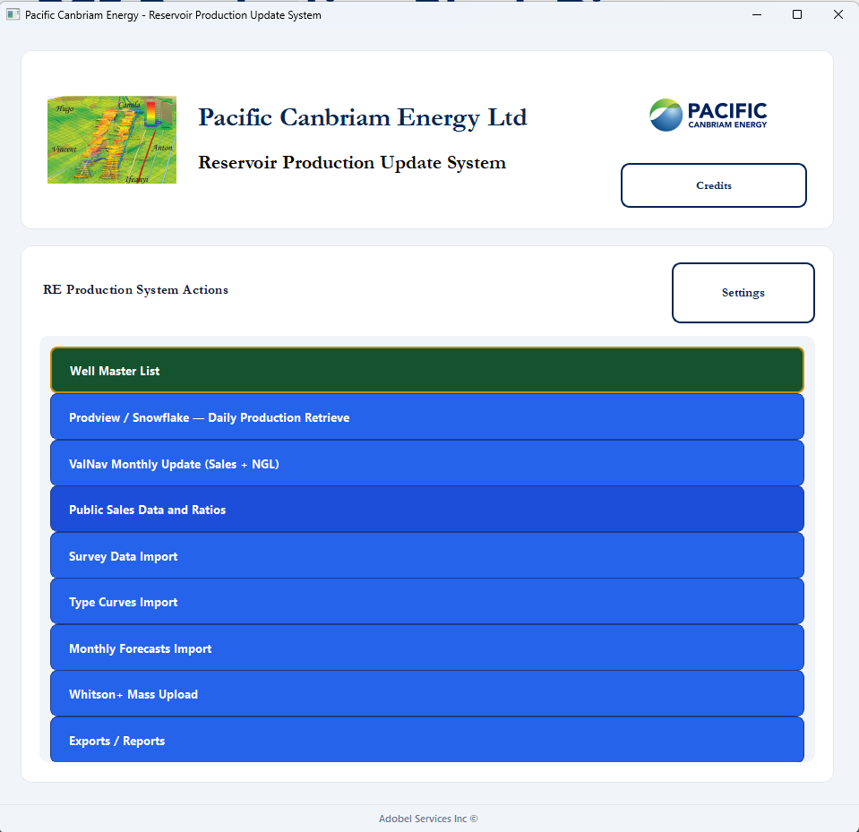
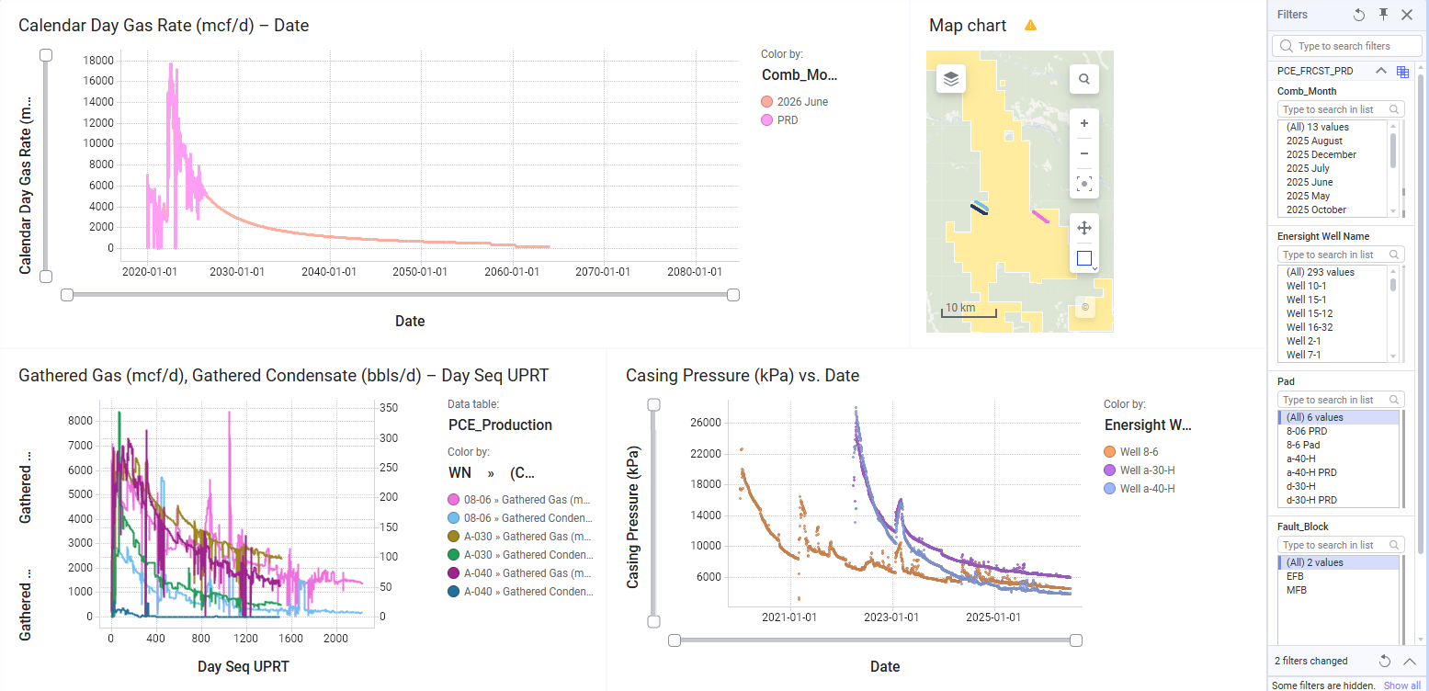
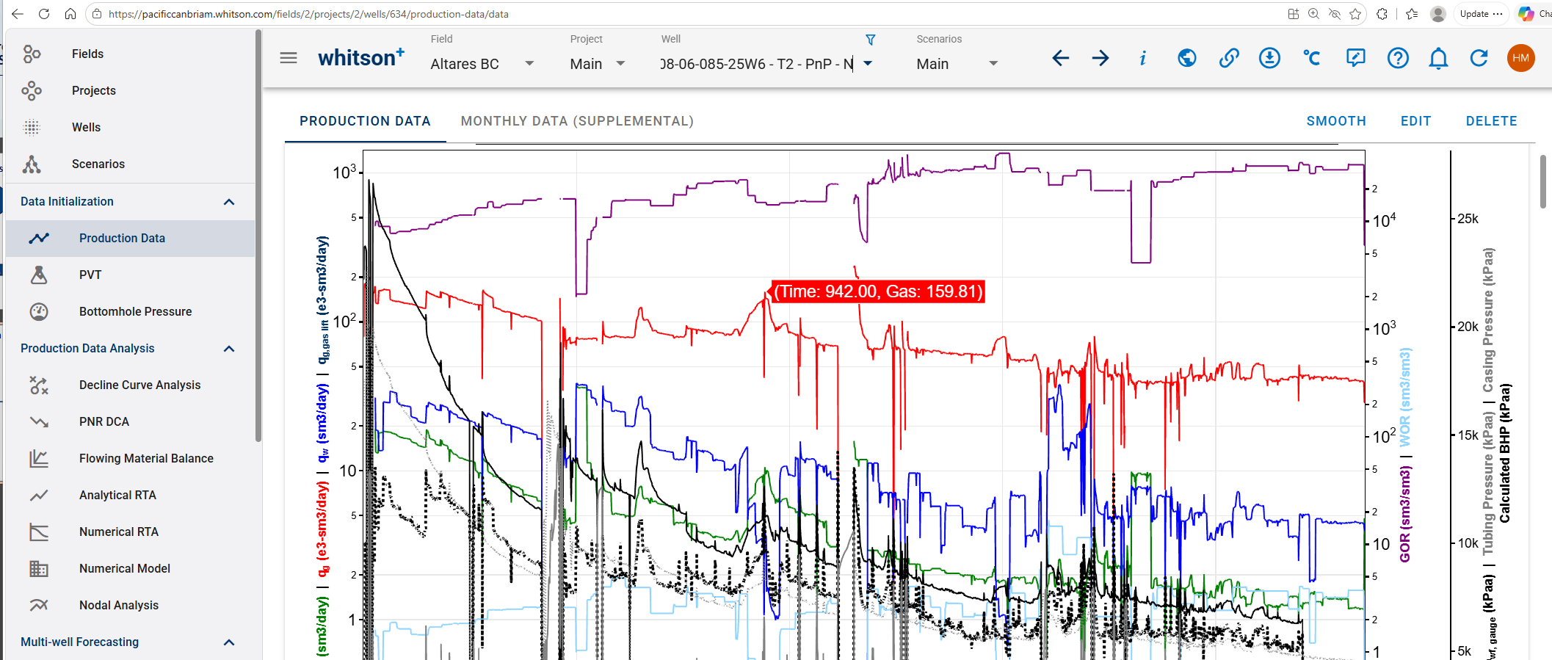
PCE Production Block Diagram
Spotfire Dashboards
ProdView/Snowflake
Well Master, Ratios, NGLs
Main PCE Production
RTDs, RTC
Production Accounting
Excel import
Production Performance Field Communication
Directional Surveys
Accumap Import
PCE Monthly Forecast
Type curves
McD, PCE, Models (Excel)
Whitson/ Harmony
Automatic Update
PCE Monthly Forecast (Valnav)
CALVMSQL01
RE_Main_Production
SQL Server DB

Slide 4
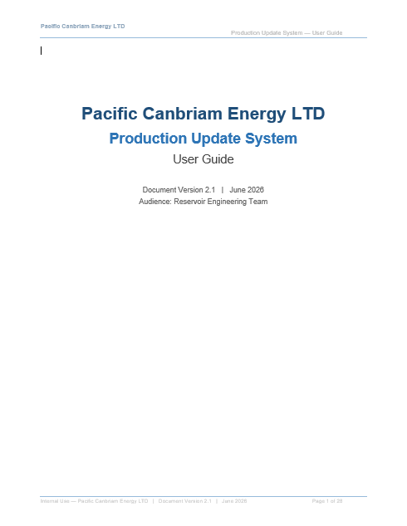
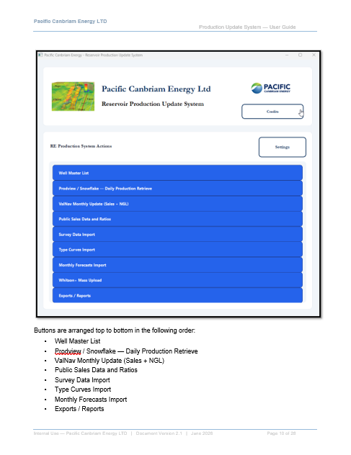
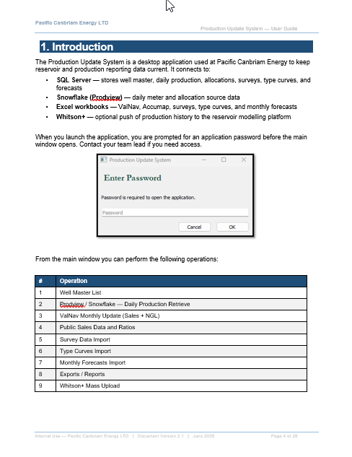
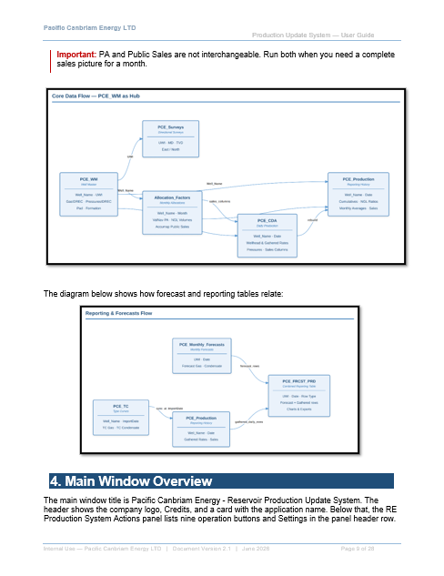
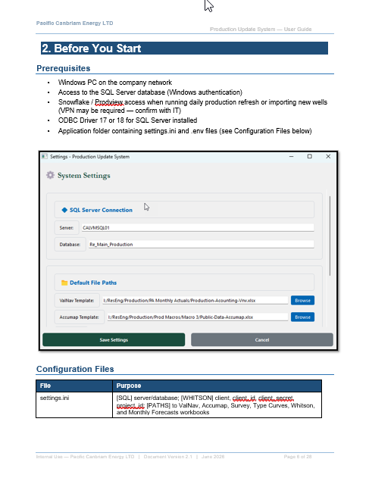
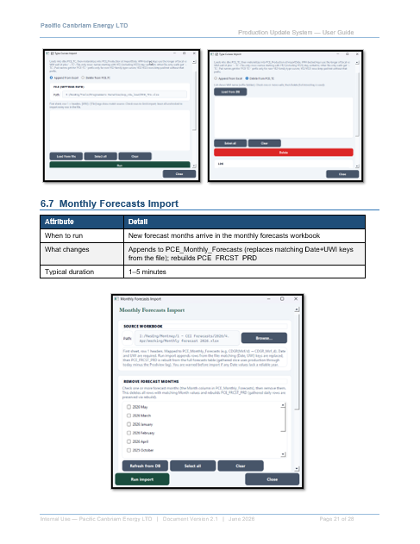
Documentation

Slide 5
Next Steps
Injectors
Flowbacks
Public Sales vs Company Sales
Adding NGL Forecasts

